Slide 1


Case Study: Bellabeat Fitness Devices
India Flores
Capstone project for Google's Data Analytics Certificate
Demonstrates use of: Google Sheets, pivot tables, CSVs

Slide 2

Business Task
Analyze trends in fitness smart device usage
Identify insights that can apply to Bellabeat customers
Offer recommendations for improving Bellabeat marketing strategies

Slide 3
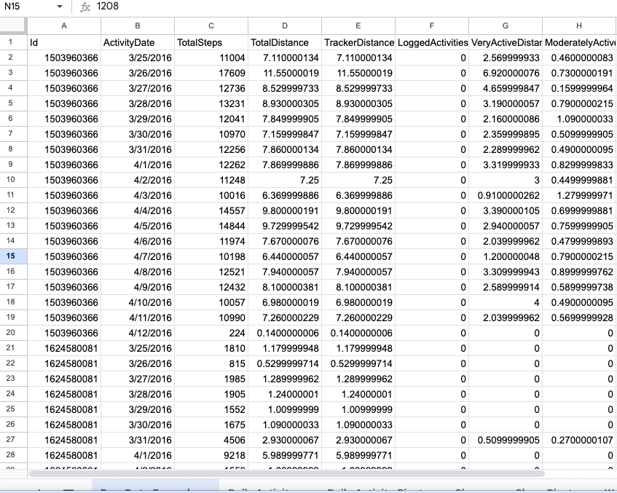
Dataset Overview
Full dataset: Bellabeat Fitness Tracker Dataset
Personal tracker data from 30 FitBit users
Includes information on physical activity, sleep, and weight
Data provides insight into daily habits and wellness patterns
Focused on three tables from the Bellabeat dataset and analyzed separately: dailyActivity_merged.csv (458 rows), weightLogInfo_merged.csv (68 rows), and sleepDay_merged.csv (414 rows)

Slide 4
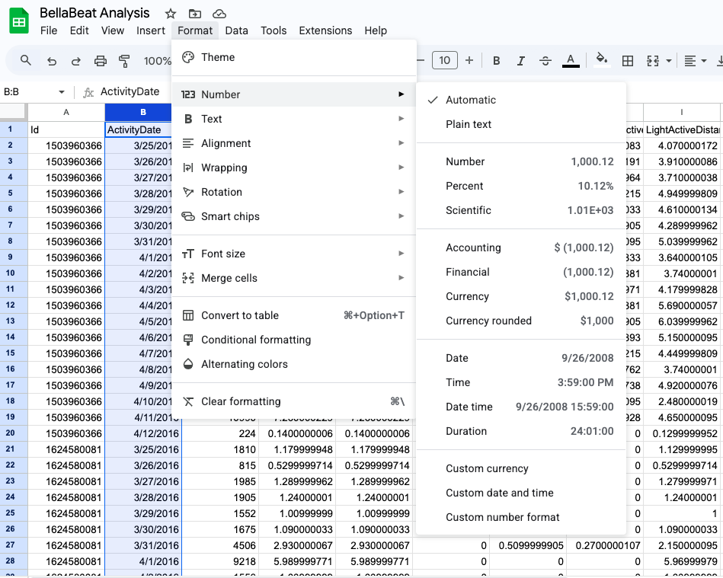
Cleaning the Data
Uploaded CSV files to Google Sheets for analysis
Removed duplicates and irrelevant columns
Standardized date and text formats
Fixed inconsistent and incorrect records
Split combined date/time columns
Verified data was clean and ready for analysis

Slide 5
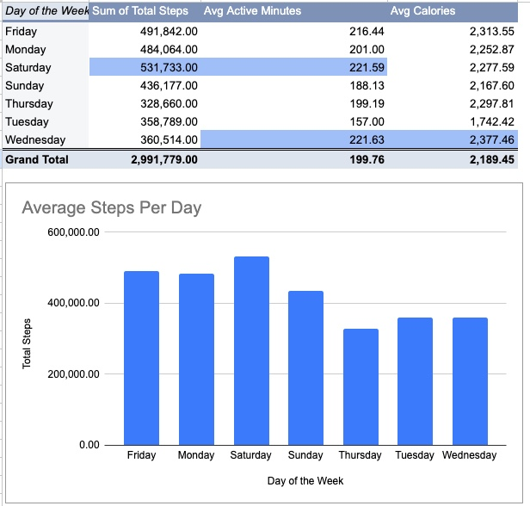
Activity Patterns
Step activity: Users took the most steps on Saturdays and the fewest on Thursdays
Active minutes: The highest active minutes per user occurred on Wednesdays and Saturdays
Calories burned: On average, users burned most calories on Wednesdays

Slide 6
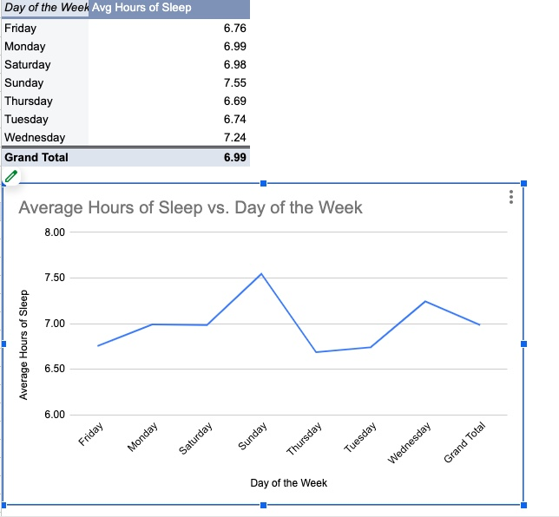
Sleep Trends
1. Sleep patterns by days of the week: Users slept the most on Sundays and the least on Thursdays
2. Overall sleep duration: on average, users burned the most calories on Wednesdays
3. Weekly trends: Sleep gradually decreases from Sunday to Tuesday, indicating a beginning of the week slump

Slide 7
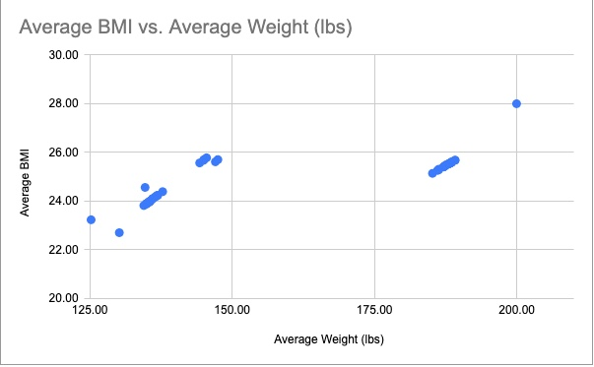
Weight Analysis
Users with higher weight generally had higher BMI; for example, those weighing 140–150 lb typically had a BMI of 25–26.
User weights ranged from 125–200 lb, with BMI ranging from ~22–28.
Most users fall within the healthy to overweight BMI range

Slide 8


Summary of Findings
The analysis of user activity, sleep, and weight data revealed clear patterns in daily habits, physical activity, and health metrics.
Users are most active Wednesdays and Saturdays
Sleep patterns vary throughout the week, showing potential opportunities for personalized wellness recommendations
Higher weight correlates with higher BMI

Slide 9

Marketing Recommendations
Increase personalized reminders on lower activity days
- data showed that users are least active Thursdays. Consider challenges, reminders, or targeted app notifications mid-week.
2. Market holistic wellness tracking
- Increase awareness of correlation between activity, sleep, and weight to overall wellness.
3. Promote high-value features on peak days
​- Users are most active on Wednesdays and Saturdays. Highlight tracking features, wellness tips, or premium content on these days.

Slide 10

Full Project
Explore the full interactive Google Sheets Project here: Bellabeat Analysis
Contains raw and cleaned datasets, pivot tables, and visualizations for activity, sleep, and weight analysis.
Further analysis could include predictive modeling, joining tables, correlation with demographic factors, or interactive dashboards.

